Slide 1
GOOGLE PLAY APPS
Campeny, Eloi
Chriki, Fatima Zohra
Dai, Zhongkai
González, Victor
Moure, Ximena
Xu, Ange

Slide 2
TABLE OF CONTENTS
01
02
03
04
05
06
07
08
09
Motivation & Problem definition
Data source presentation
Data structure and metadata description
Preprocessing
Basic initial descriptive statistics of preprocessed variables and conclusions
PCA for numerical variables
MCA of multiple qualitative variables
Multiple Factorial Analysis
Association rules mining analysis

Slide 3
01
Motivation & Problem definition

Slide 4

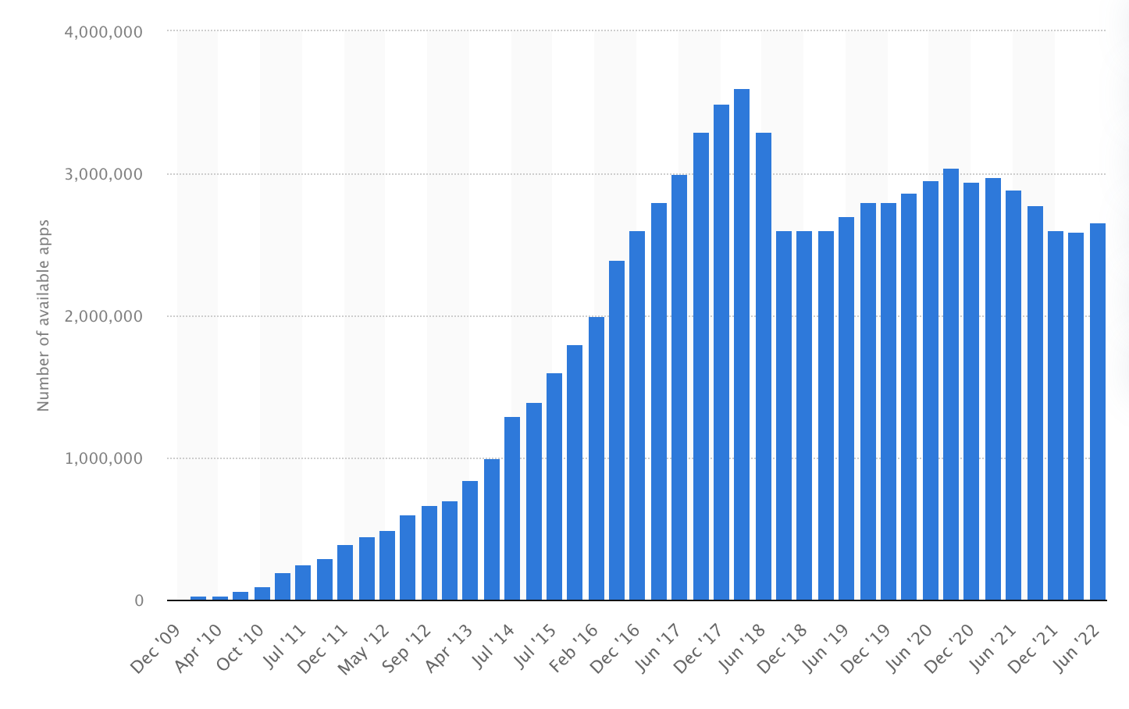

Motivation & Problem definition
+2500 daily additions
Analyze which factors can influence the number of downloads and the rating of an app

Slide 5
02
Data source presentation

Slide 6
Data source presentation
Data taken from Kaggle
Collected in 2021
Original dataset: 2.312.944 observations
Reduced dataset: 20.000 observations

Slide 7
03
Data structure and metadata description

Slide 8
Data structure and metadata description
24 variables
5 numerical: Rating, Rating.Count, Minimum.Installs, Maximum.Installs and Price
4 binary: Free, Ad.Supported, In.App.Purchases and Editors.Choice
15 categorical: Category, Installs, Size, Released, Last.Updated, Content.Rating,Scrapped.Time,Developer.Email, Developer.Website, etc.
10911 missing values (2.27%)
Variables eliminated and transformed during preprocessing

Slide 9
04
Preprocessing

Slide 10
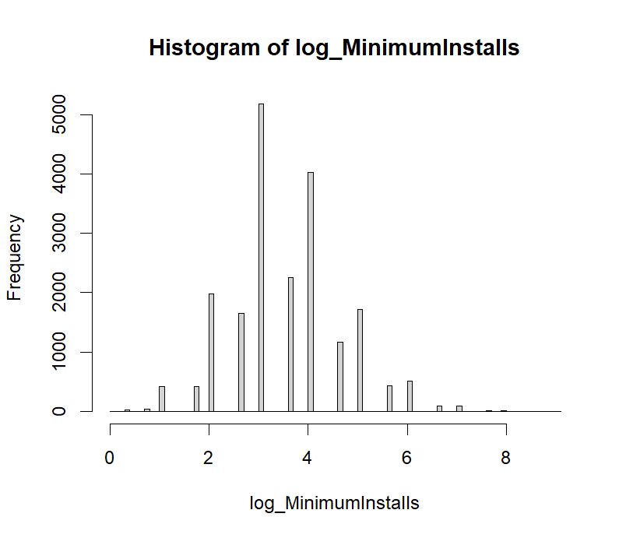
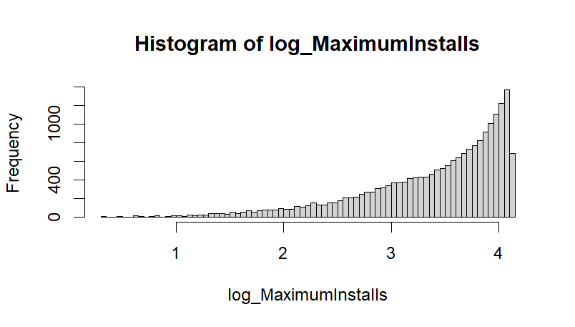
Preprocessing
Feature selection
Unique value for each observation
Developer.Website, Developer.Email, Developer.Id, App.Id, Privacy.Policy
Unique value for all observations
Editors.Choice
Highly correlated
Installs , Minimum.Installs, Maximum.Installs Installs

Slide 11
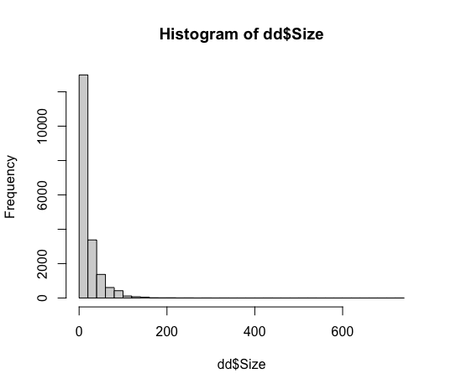
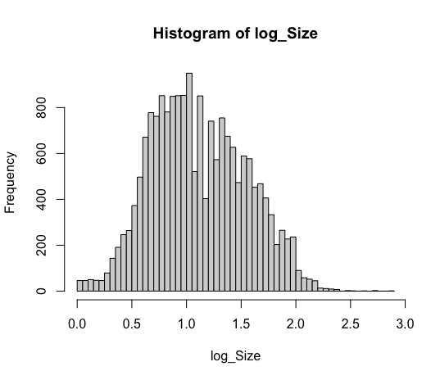
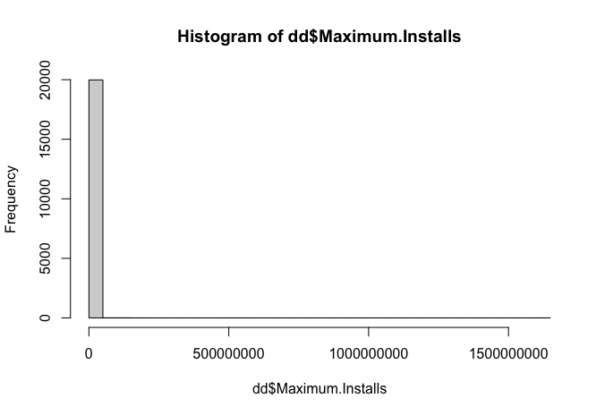
Preprocessing
Derivation of new variables
Scraped.Time, Last.Updated DaysLastUpdate
Scraped.Time, Release ReleaseDays
App.Name AppNameLen
Transformations
Categorial Size (GB, MB, KB) Numerical
Size, Installs and Rating.Count Logarithmic transformation
Reduced modalities for Category and Minimum.Android

Slide 12
Preprocessing
Segmentation of population
Paid vs Free Apps
Kolmogorov-Smirnov test (KS test)
Divided dataset: Paid apps and Free Apps
Performed the test for each numerical variable
Result: p-value < 0.05 for almost every variable
Conclusion: There is more than one population

Slide 13
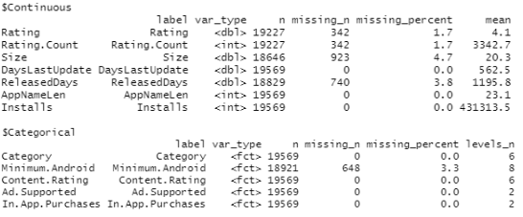
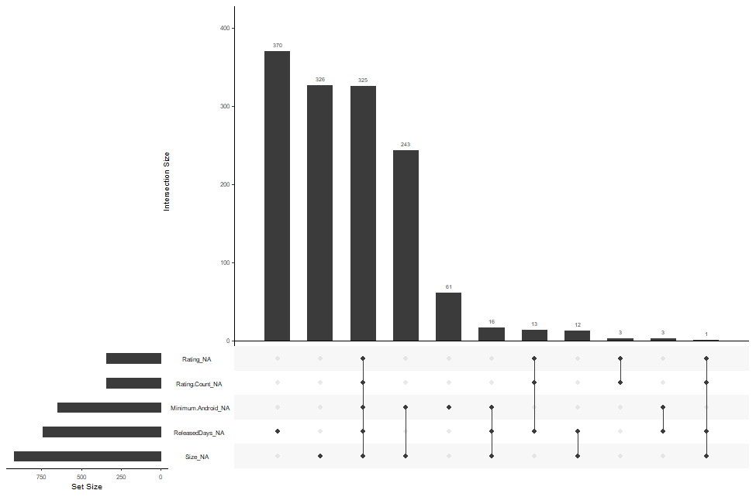
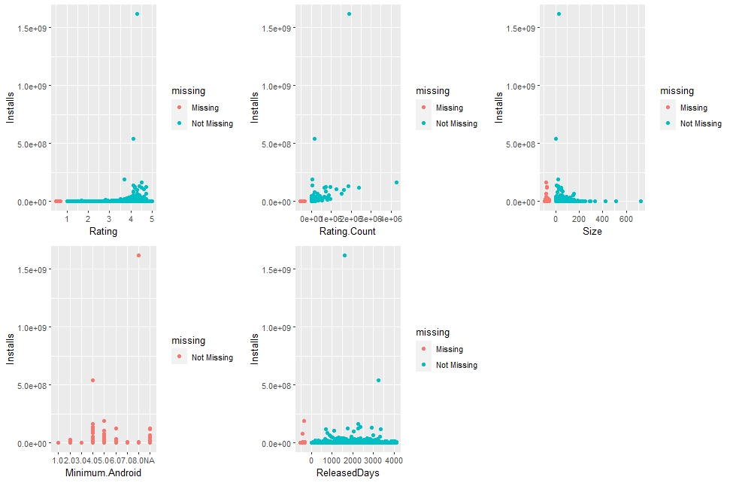
Missing data treatment
Identifying missing values
Identify variables affected
Identify type of missing data
Little Test result: p=0
Analysis of missing data -> MAR

Slide 14
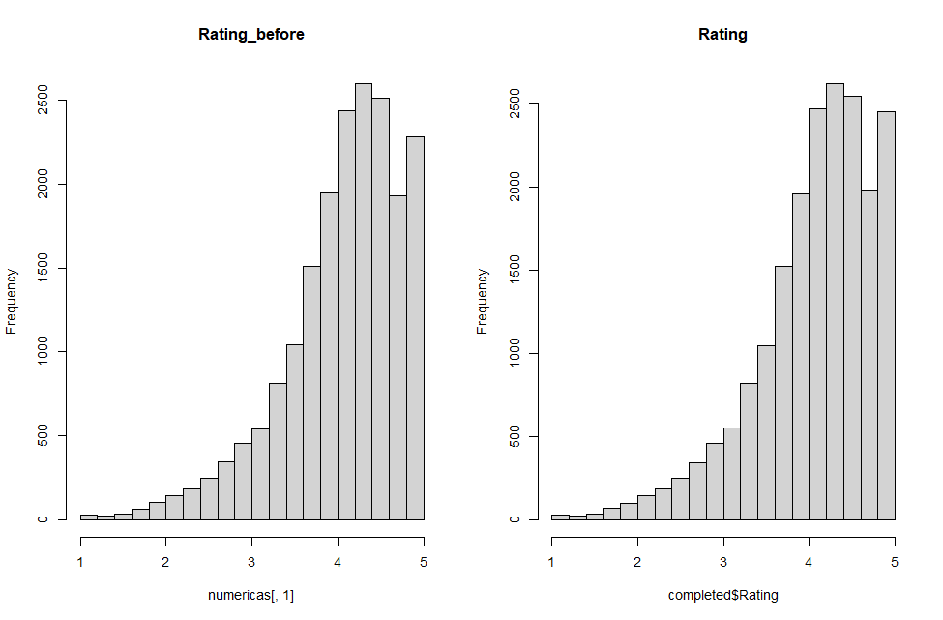
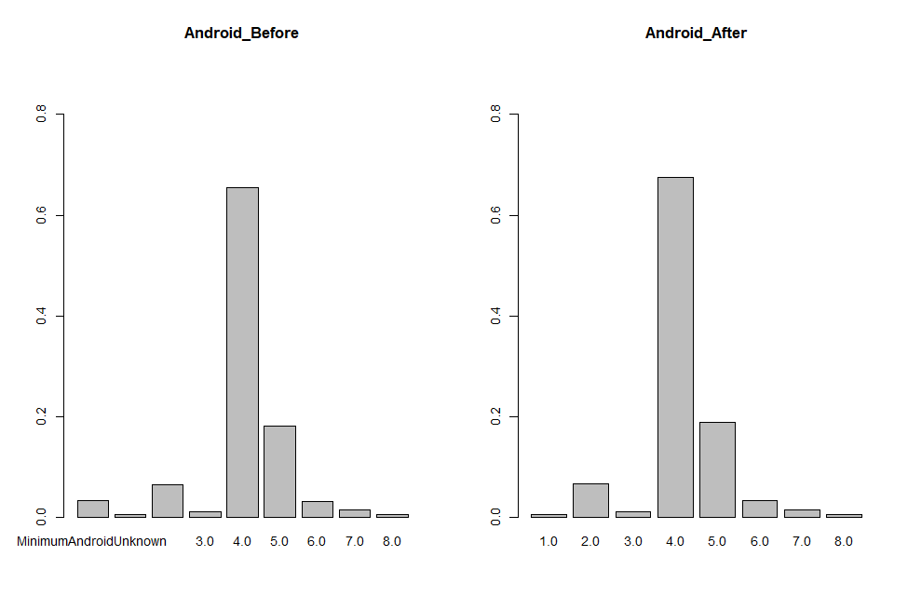
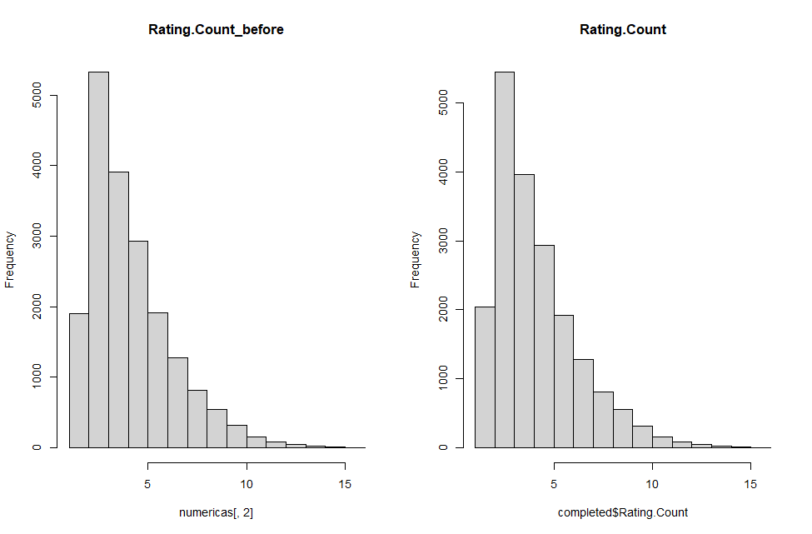
Missing data treatment
Treating missing values
MICE with numerical data
MICE with categorical data

Slide 15
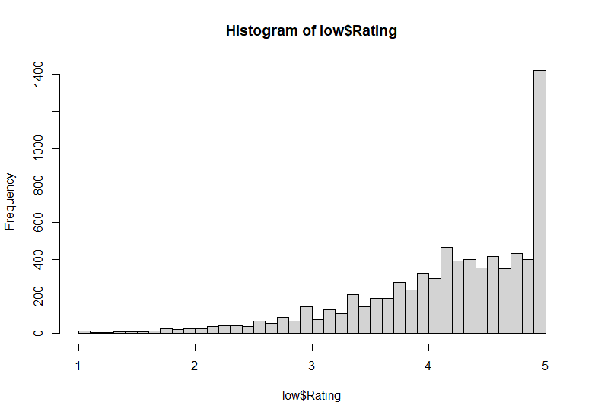
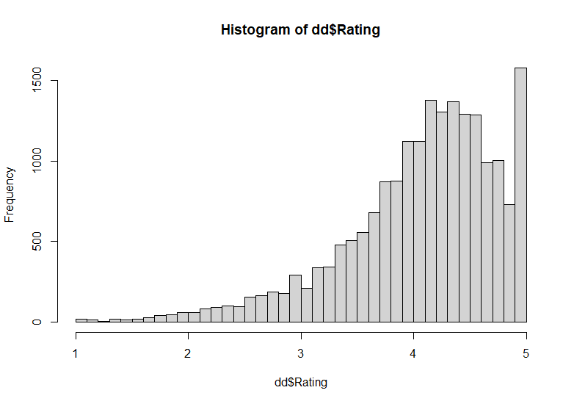
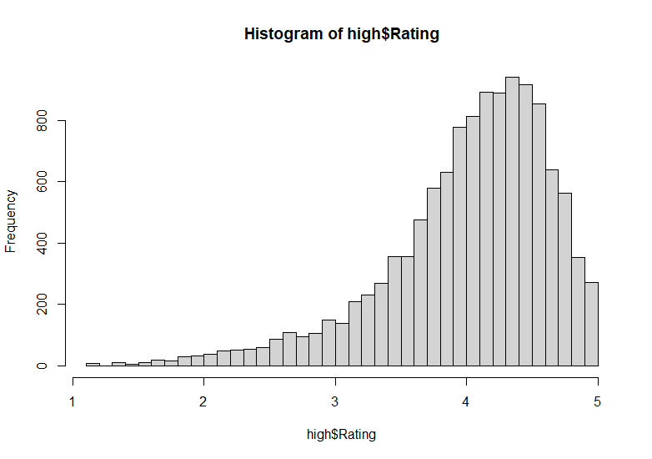
Missing data treatment
Univariate detection of outliers
Rating analysis
Kolmogorov–Smirnov test and plot
Different populations, keep Rating.Count>20

Slide 16
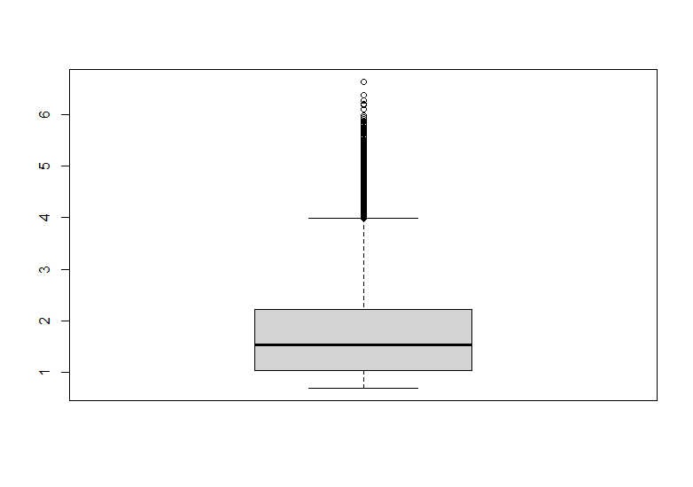
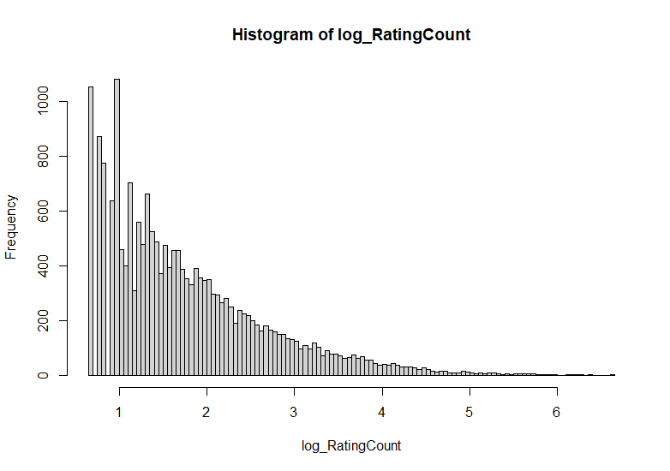
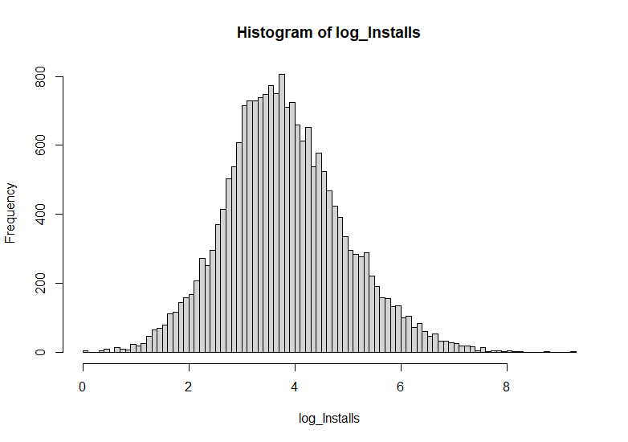
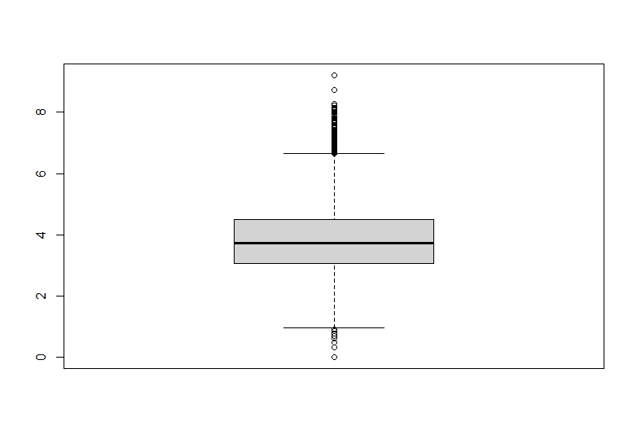
Missing data treatment
Univariate detection of outliers
Rating.Count
Installs

Slide 17
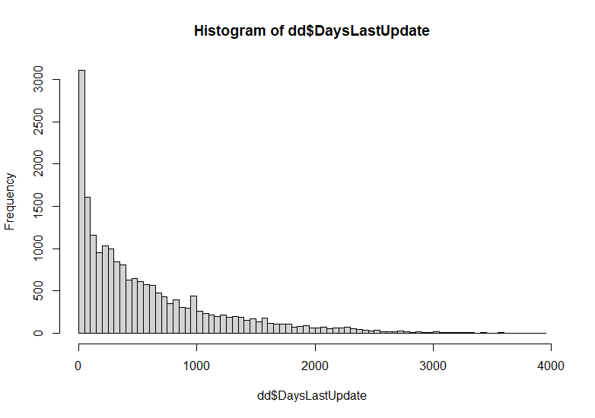
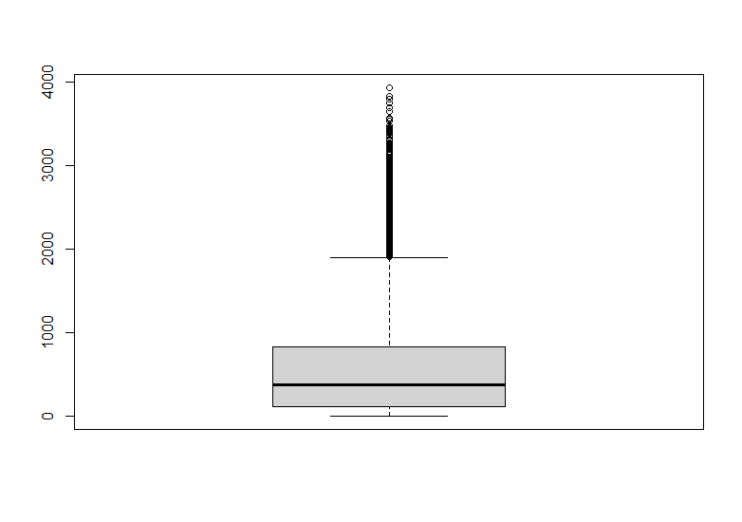
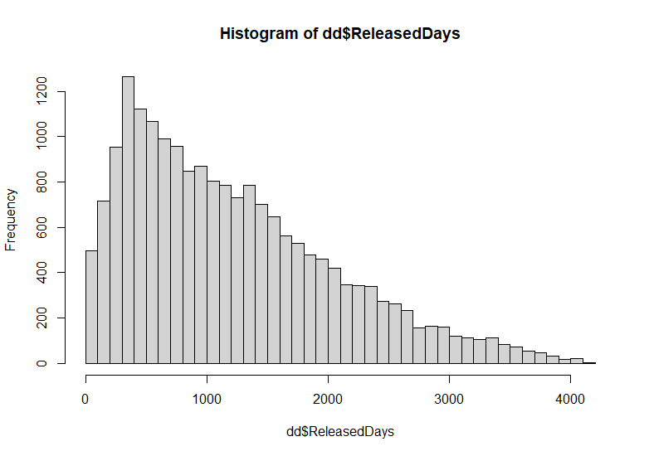
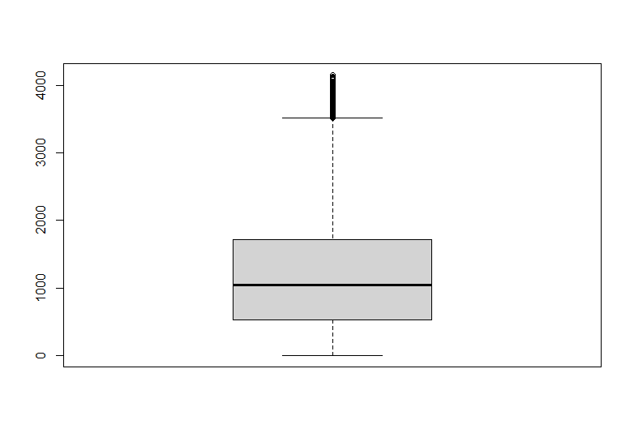
Missing data treatment
Univariate detection of outliers
DaysLastUpdated
ReleasedDays
Multivariate Outliers
Mahalanobis distance

Slide 18
05
Basic initial descriptive statistics of preprocessed variables and conclusions

Slide 19
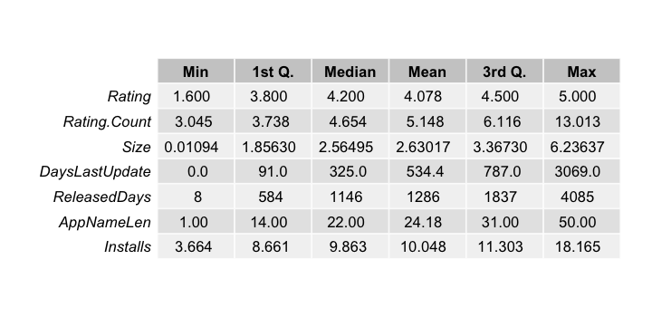
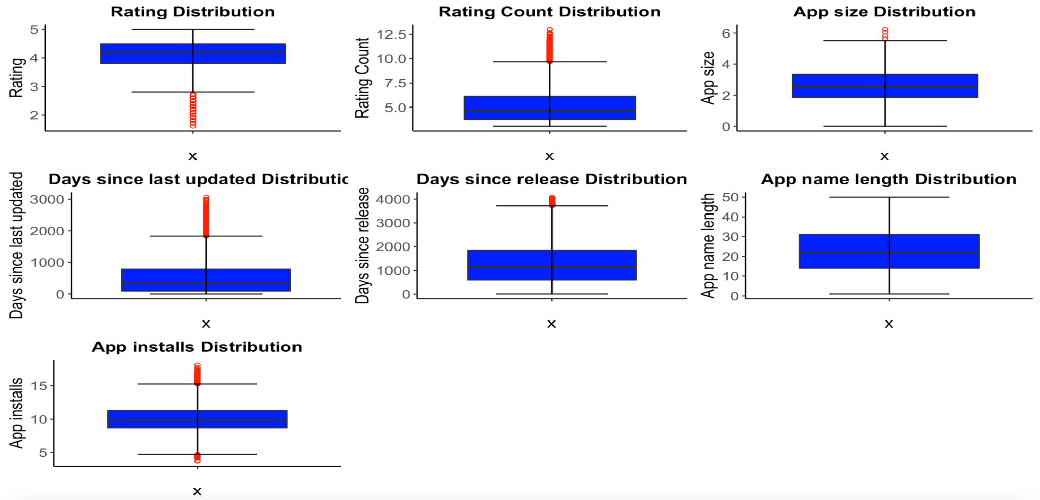
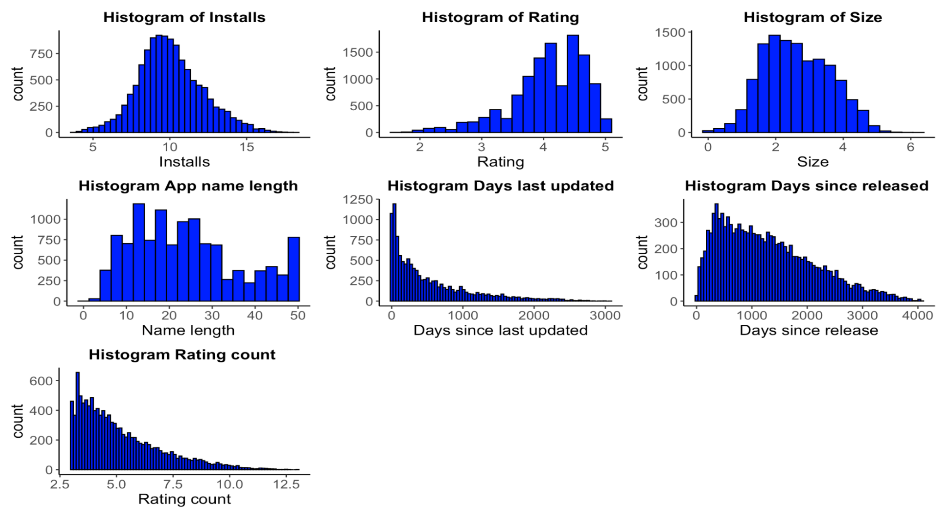
Univariate analysis
Univariate analysis
Basic values, histograms and boxplots
Low Rating count respect Installs
Rating 4+
Name length 30-10

Slide 20
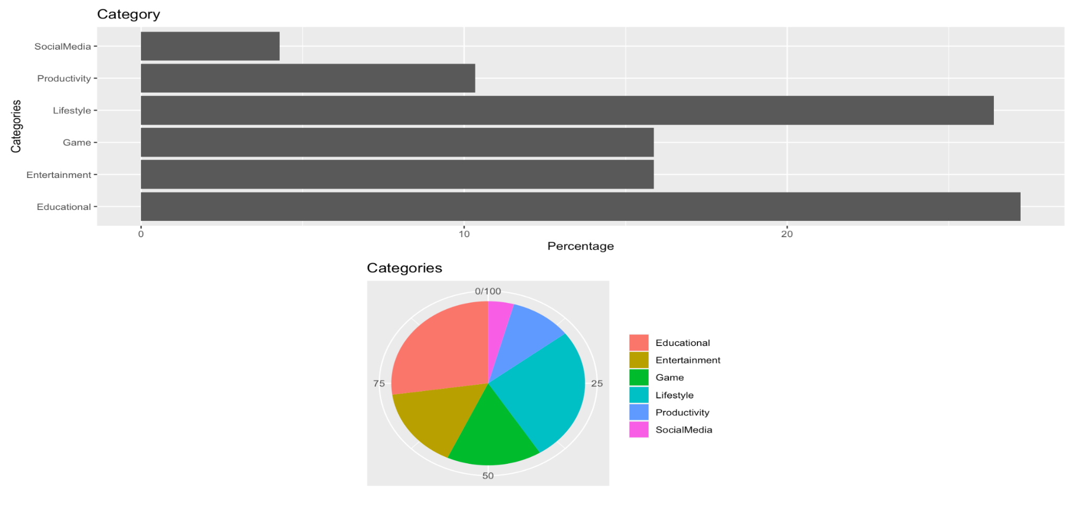
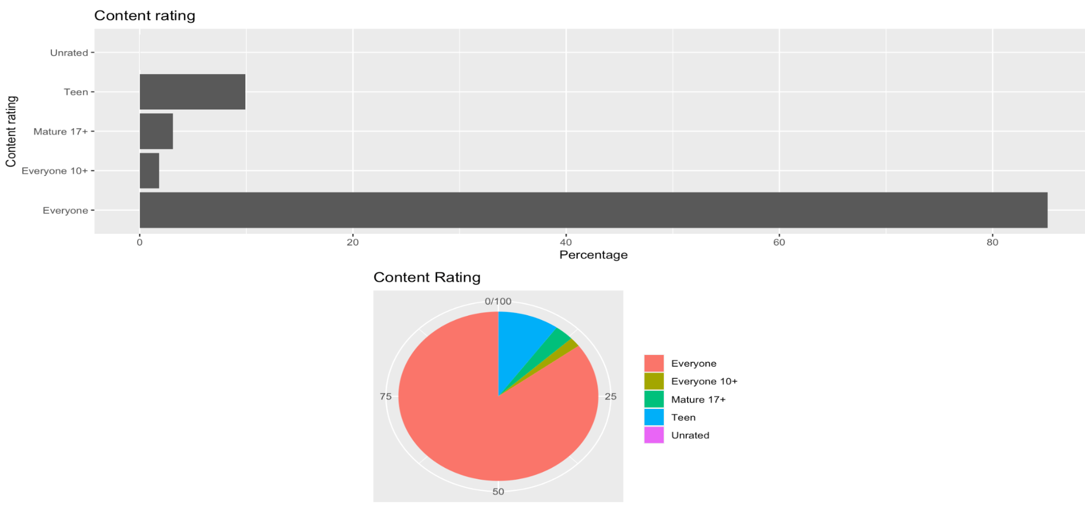
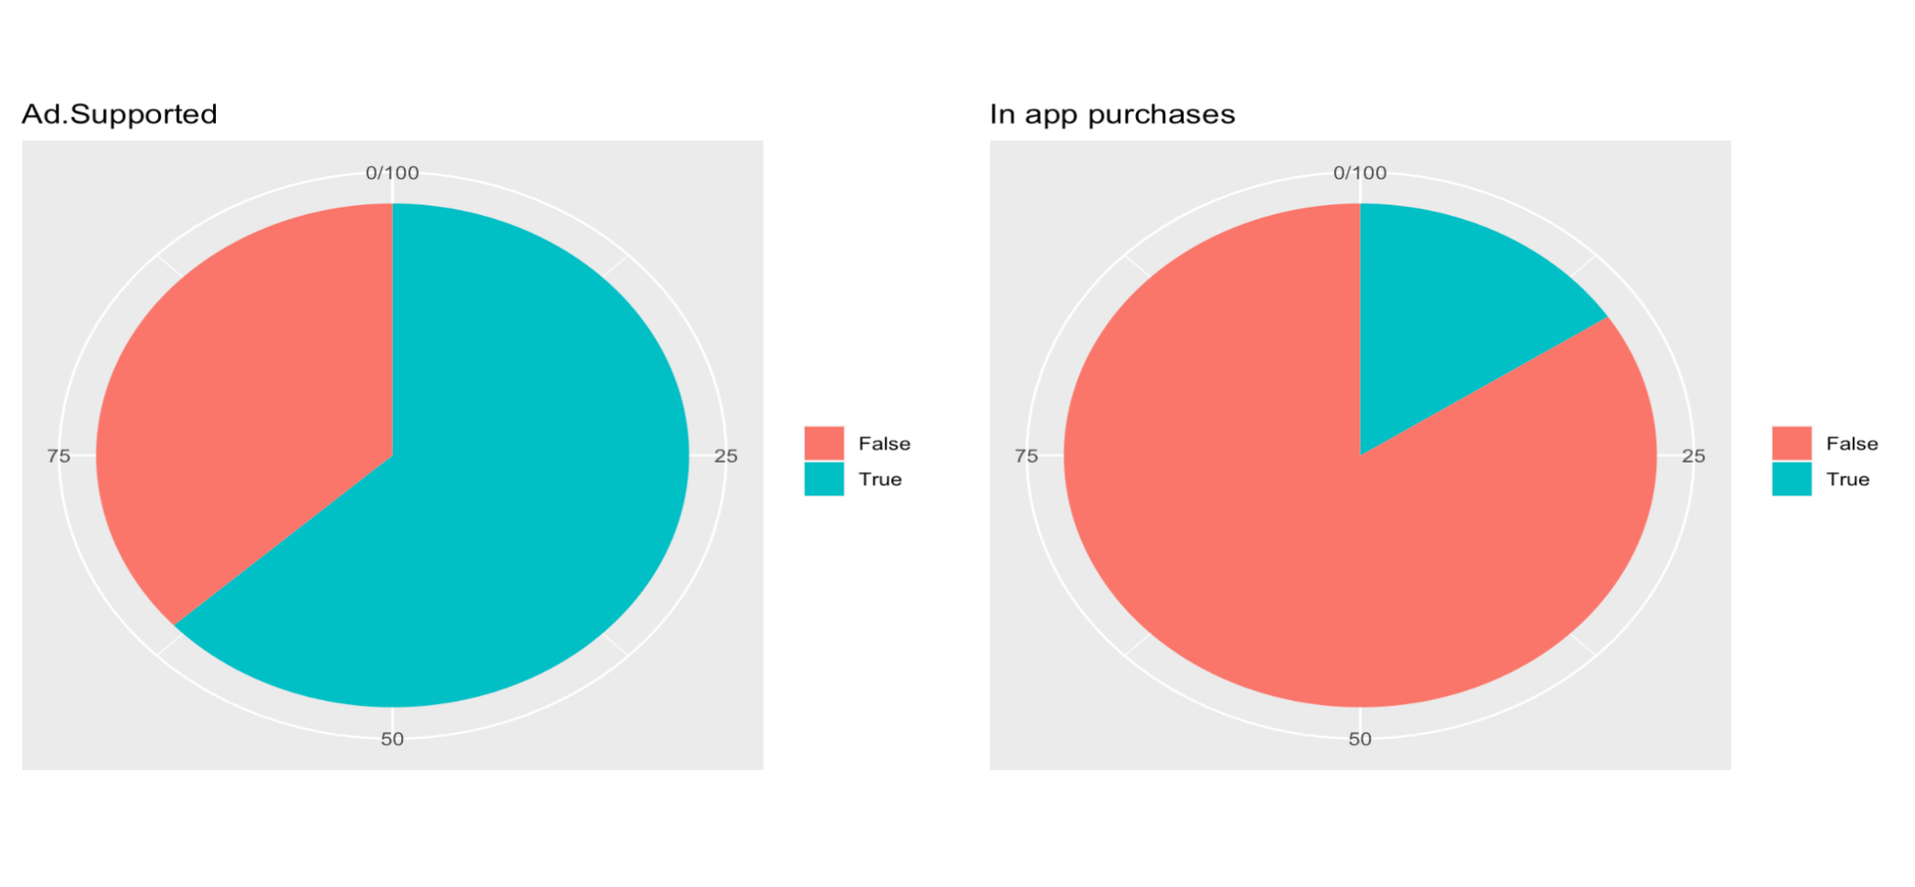
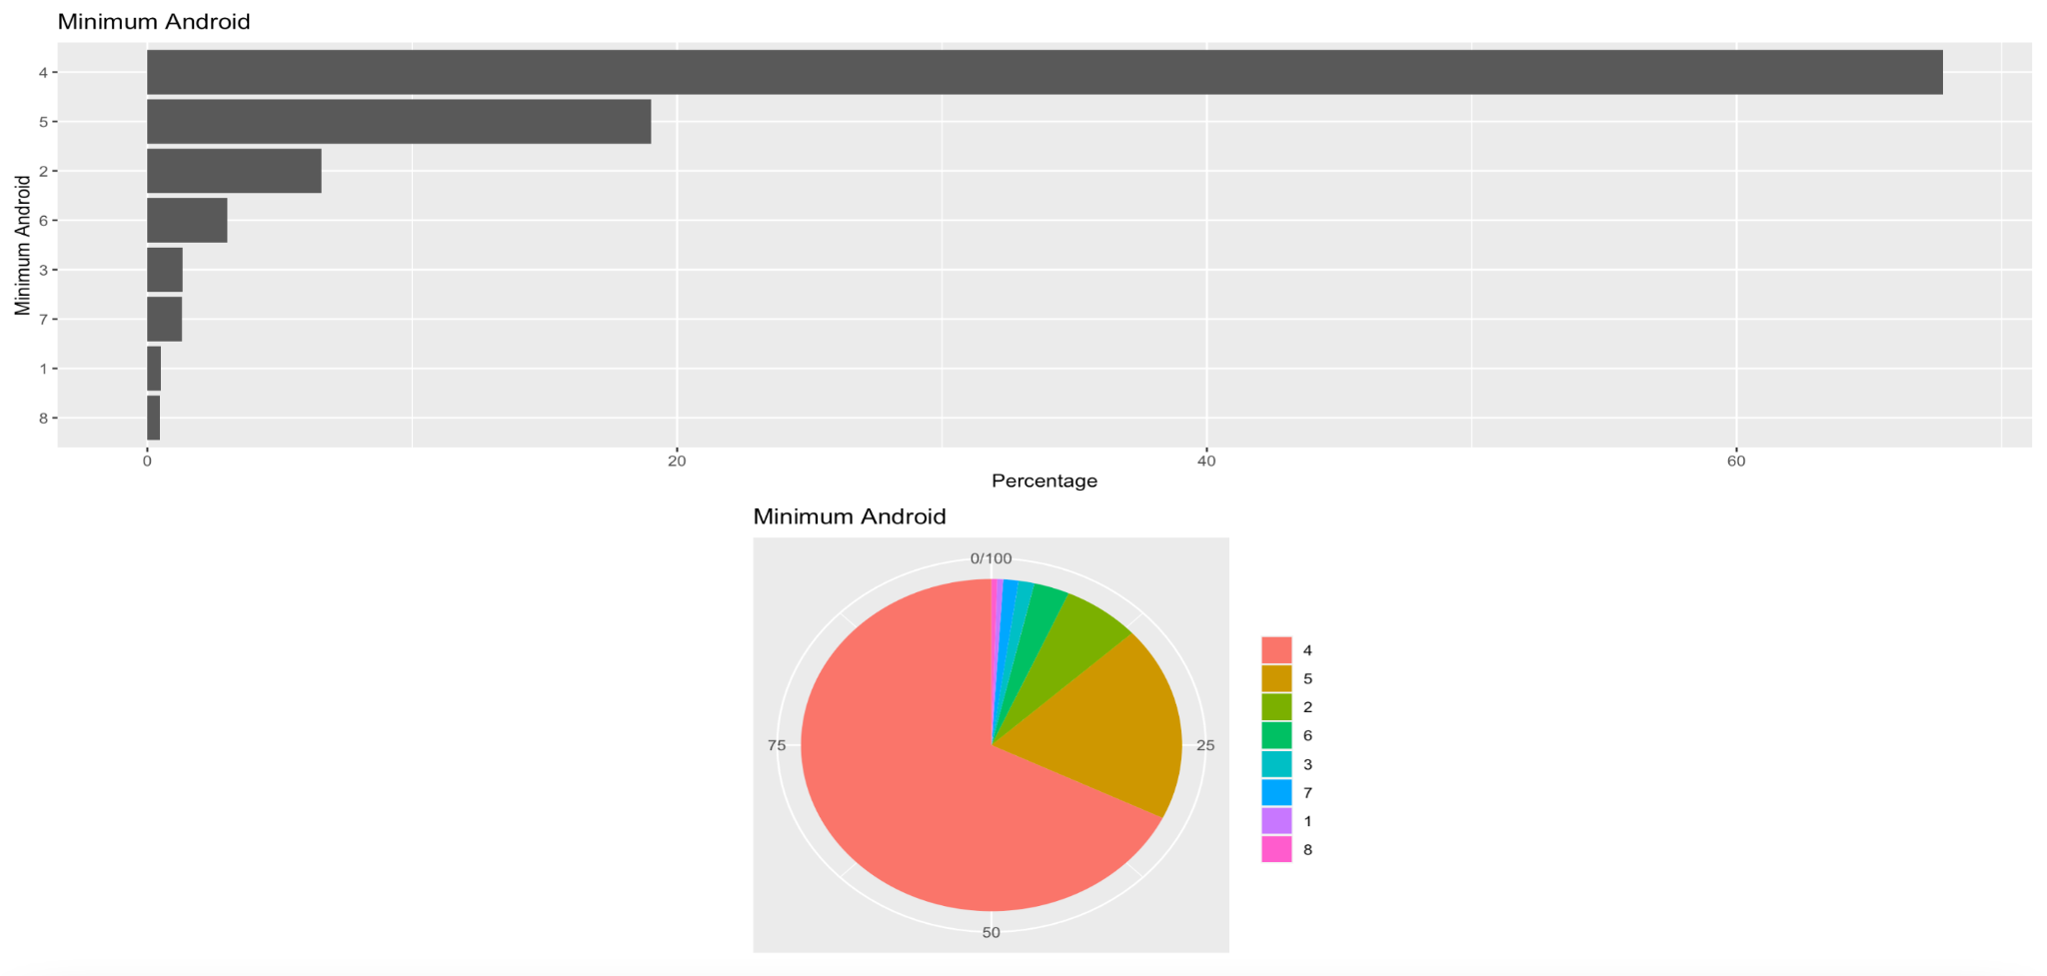
Univariate analysis
Univariate analysis
Pie charts
In app purchases and adds
Educational>Lifestyle>Games>Entertainment
Everyone and Android 4+

Slide 21
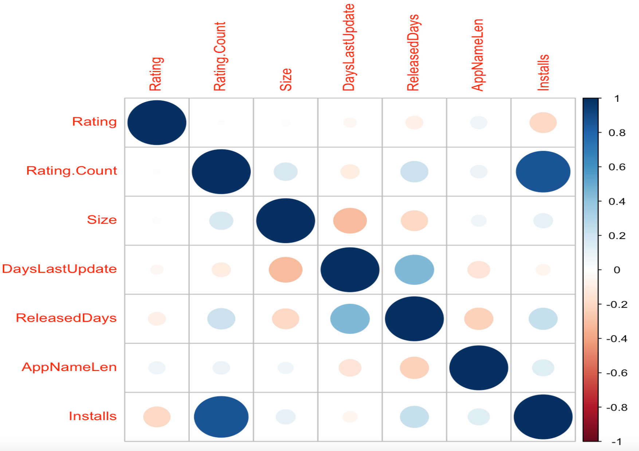
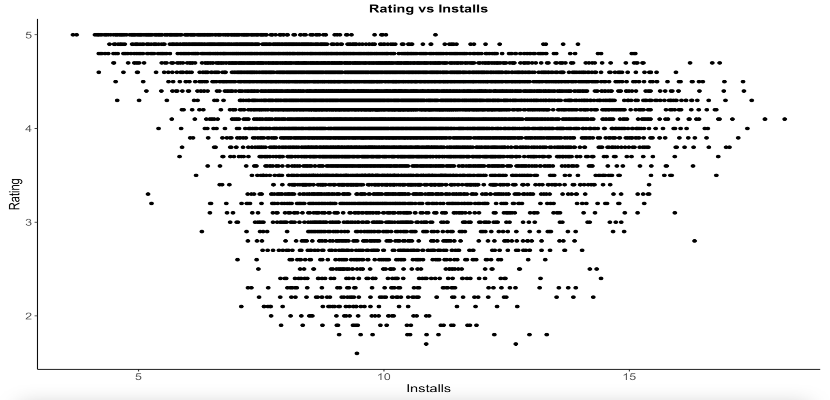
Bivariate analysis
Bivariate analysis
Correlation matrix
Positive correlation Installation+Rating.Count
Positive correlation DaysLastUpdate+ReleasedDays
Rating vs installs
Extremes higher scores

Slide 22
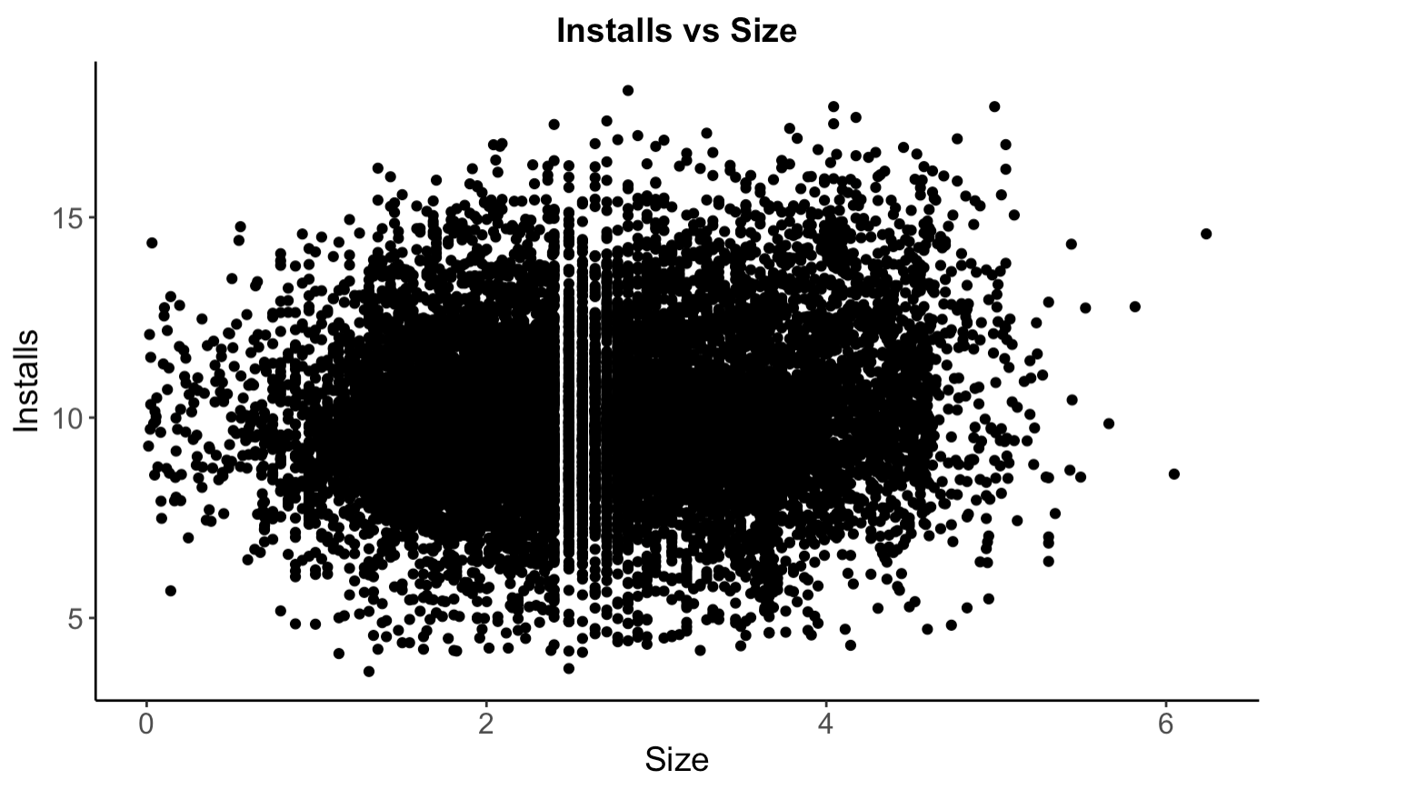
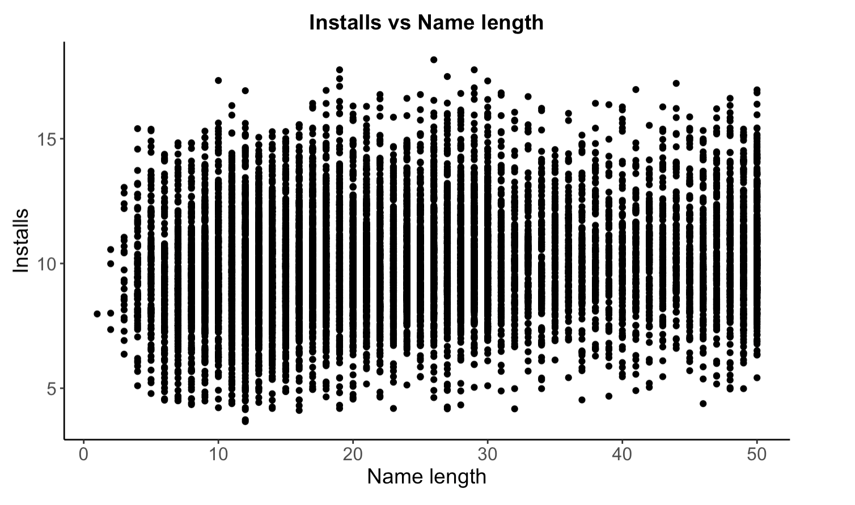
Bivariate analysis
Bivariate analysis
Install vs size
Installs vs Name length

Slide 23
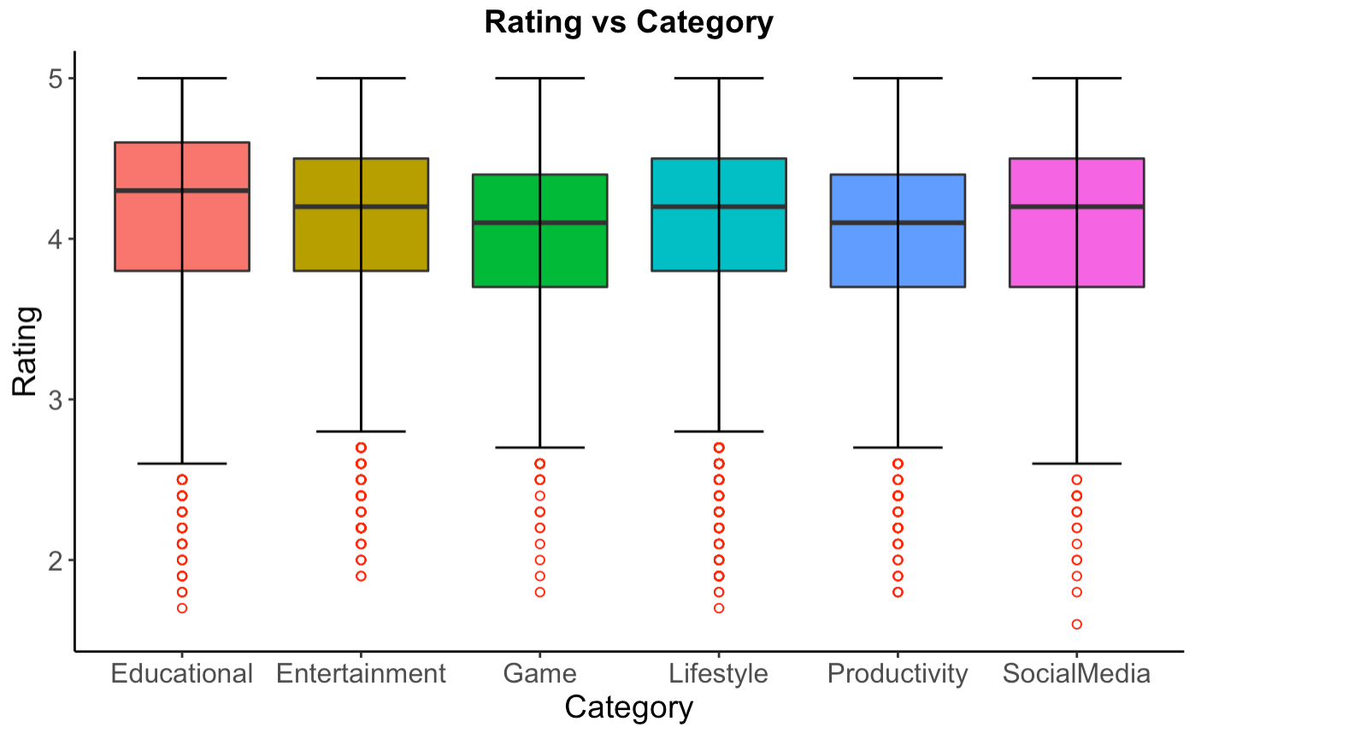
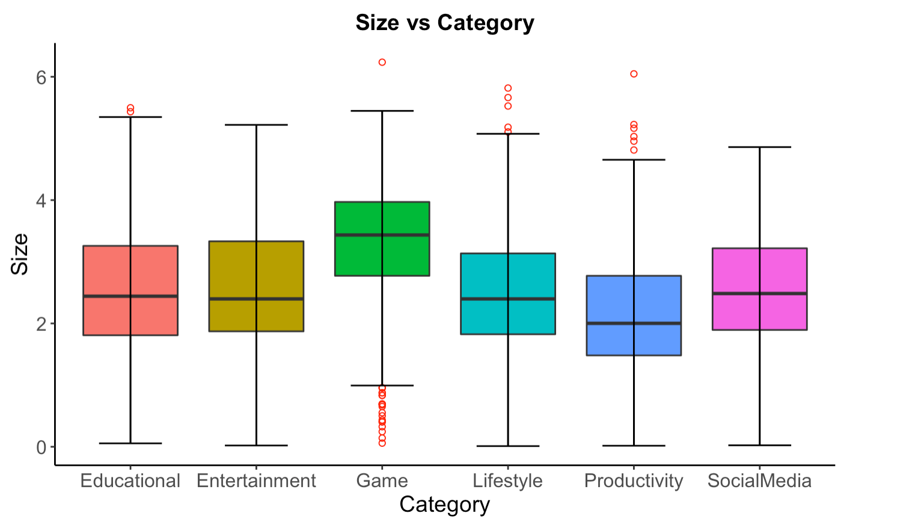
Bivariate analysis
Bivariate analysis
Rating vs Category
Size vs Category

Slide 24
06
PCA for numerical variables

Slide 25
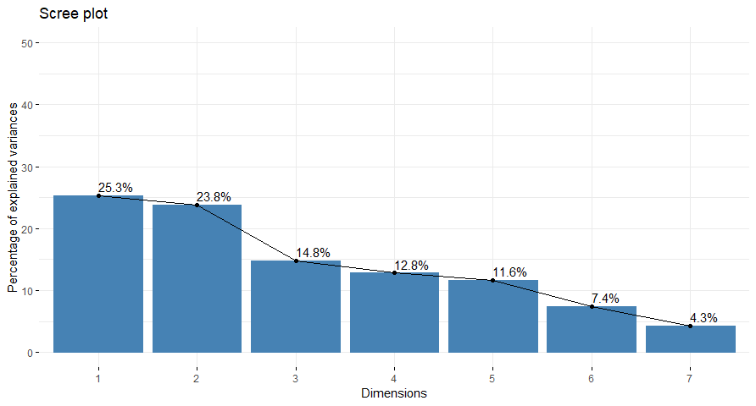
PCA: Variance retained by each component
7 numerical variables
The first three components satisfied with 63.91% of the total variance

Slide 26
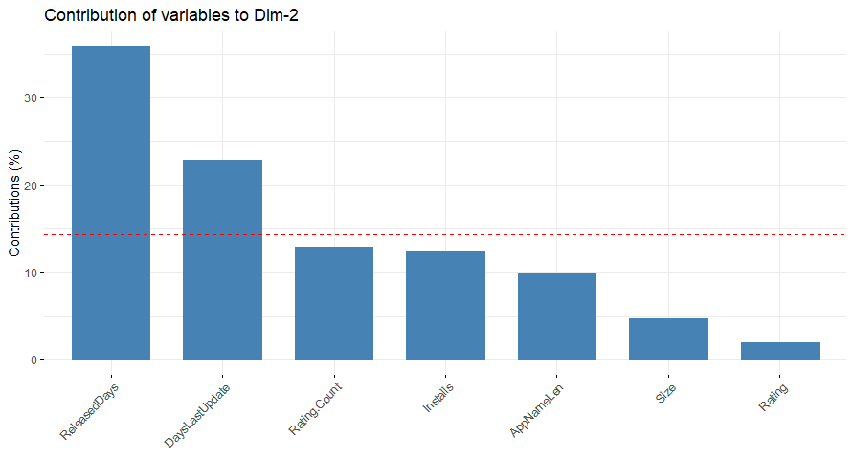
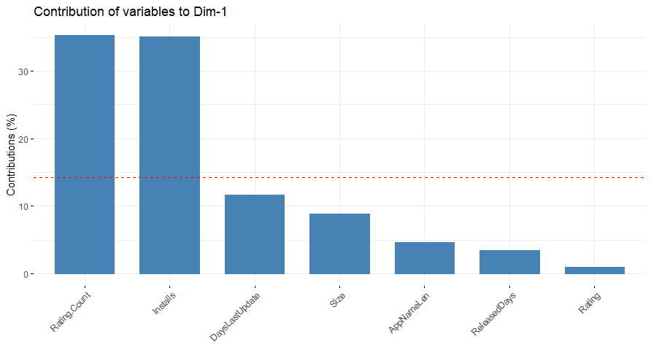
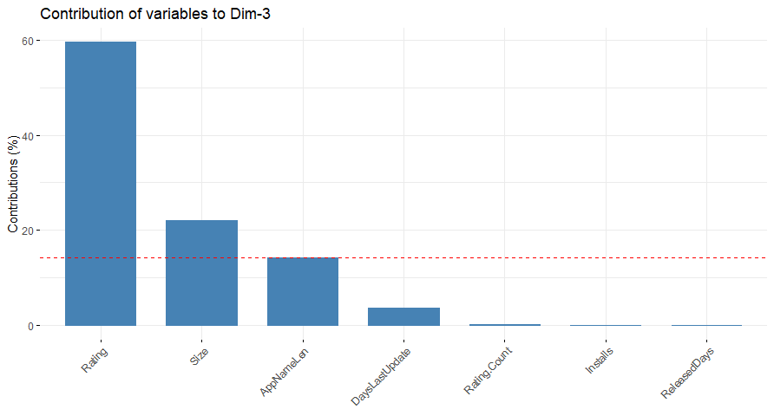
PCA: Contributions of variables to components
Meaning of PC2: Antiquity
Meaning of PC1: Popularity
Meaning of PC3:Rating & app characteristics

Slide 27
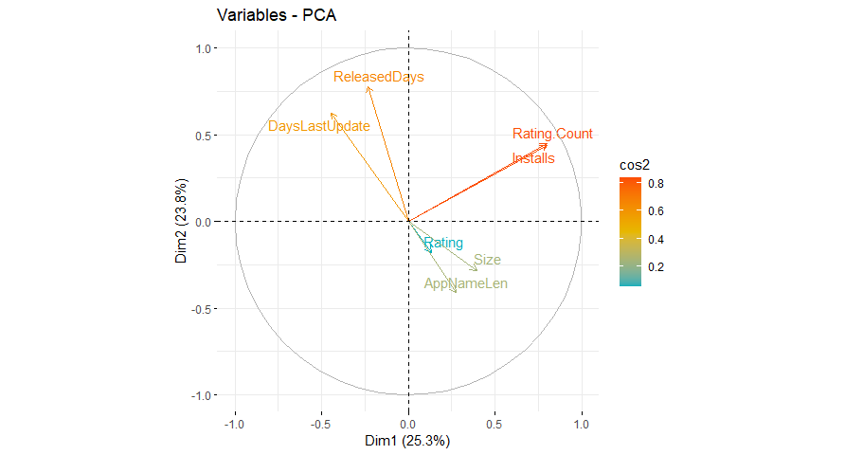
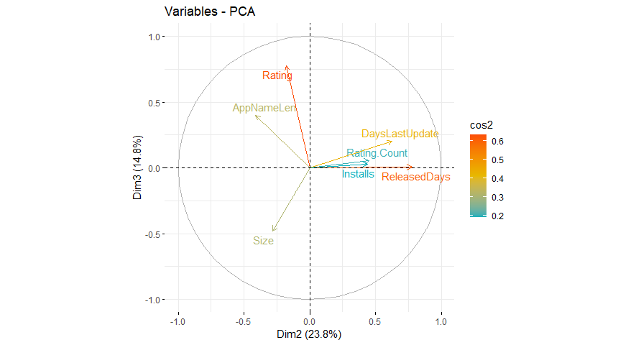
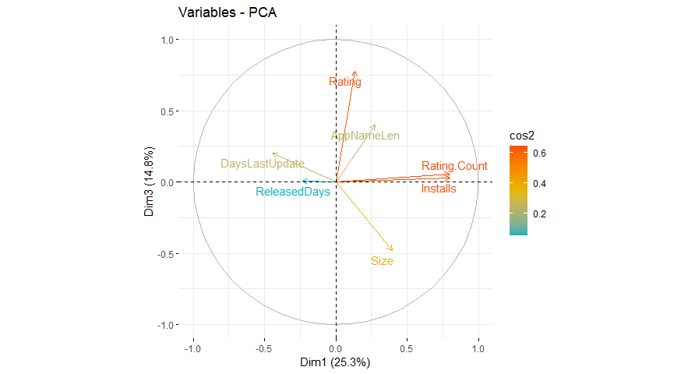
PCA: Correlation of variables to components
Dimensions 1-2
Dimensions 2-3
Rating.Count,DaysLastUpdated and Installs are correlated with both PC1 and PC2
Dimensions 1-3

Slide 28
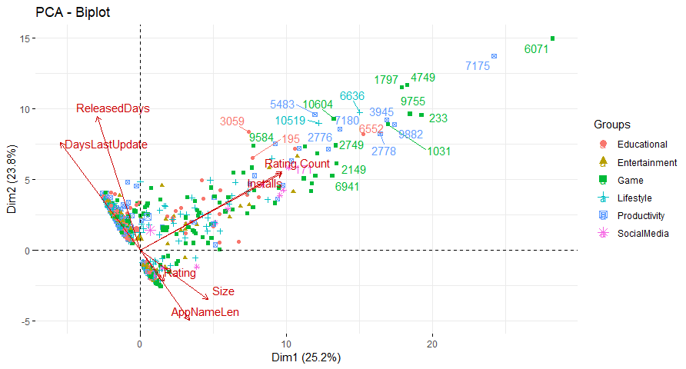
PCA: Biplots of individuals and variables
Dimensions 1-2

Slide 29
07
MCA of multiple qualitative variables

Slide 30
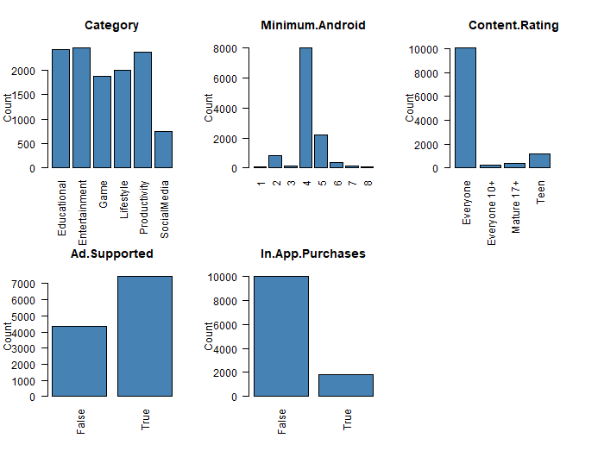
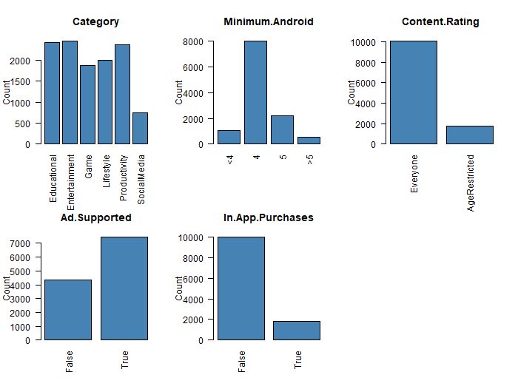
MCA: Detection of low frequency variable categories

Slide 31
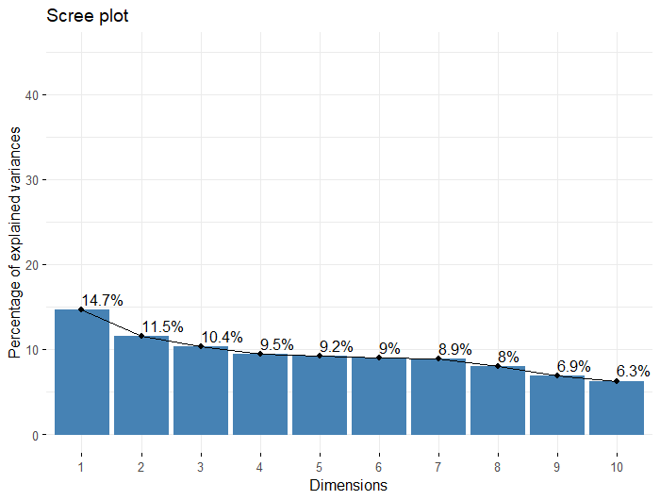
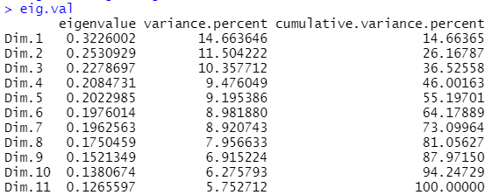
MCA: Eigen values
p = 5, 1/p = 0.2

Slide 32
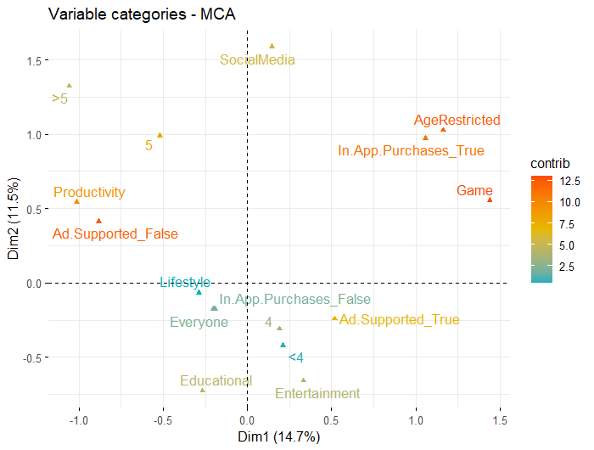
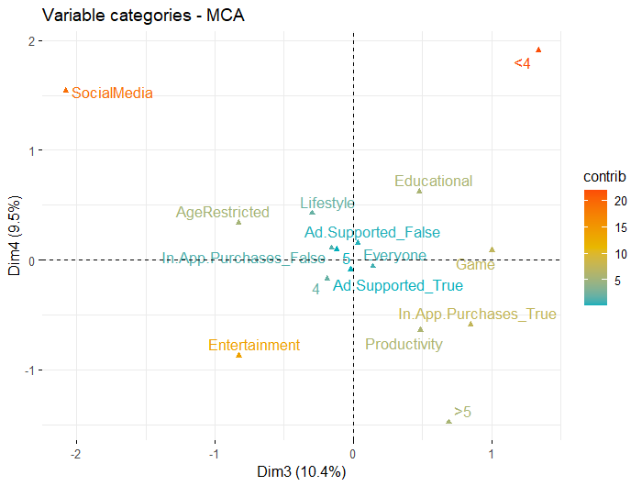

MCA: Labeling the dimensions
Dim 1: Level of entertainment
Dim 2: Level of procrastination
Dim 3: Level of companionship
Dim 4: Longevity
Dim 5: Helpfulness in a person’s lifestyle

Slide 33

MCA: Individuals by groups

Slide 34
08
Multiple Factorial Analysis

Slide 35

Groups & dimensions
5 Groups
Antiquity
Popularity
App Features
Topic
Monetization
3 DIMS
65.35% of cumulative
variance

Slide 36



Dimensions 1 & 2

Slide 37



Dimensions 1 & 3

Slide 38



Dimensions 2 & 3

Slide 39
09
Association Rules

Slide 40



Association Rules

Slide 41

Association Rules
Content Rating = Everyone &
In App Purchases = False &
Installs = Low
Rating = High
Content Rating = Everyone &
Installs = Low
Rating = High
In App Purchases = False &
Installs = Low
Rating = High
0.14 < Support < 0.19
0.54 < Confidence < 0.56
1.4 < Lift < 1.5
Content Rating = Everyone &
In App Purchases = False &
Installs = Low
Rating = High

Slide 42

Association Rules
Rating Count = High & Release Days = High
Installs = High
Rating Count = High & Content Rating = Everyone
Installs = High
9 Rules
Rating Count = High &
Content Rating = Everyone &
Ad Supported = True
Installs = High
…
…
…
0.13 < Support < 0.28
0.72 < Confidence < 0.88
2.18 < Lift < 2.62

Slide 43

Association Rules
Content Rating = Everyone &
In App Purchases = False &
Rating = High
Installs = Low
In App Purchases = False &
Rating = High
Installs = Low
0.14 < Support < 0.17
0.51 < Confidence < 0.53
1.53 < Lift < 1.57

Slide 44
Thank you for your attention
Any questions?

